Slide 1

ARTIFICIAL INTELLIGENCE-MACHINE LEARNING PROJECT
Chitkara University Institute of Engineering and Technology,
Chitkara University, Punjab
Expense Tracker: A Tool for Financial Management
Empowering Users to Take Control of Their Finances
SUBMITTED BY: SUBMITTED TO:
Presented by: Jaskirat Singh Dr.Shagun Sharma
Roll Number: 2210990445 Mr.Tushar Khitoliya
Date: 19.03.2024

Slide 2
TABLE OF CONTENT
INTRODUCTION
PROBLEM STATEMENT
PROGRAM FEATURES
ADD EXPENSE FUNCTIONALITY
DISPLAY EXPENSES FUNCTIONALITY
VISUALISATION
CONCLUSION

Slide 3
PROBLEM
STATEMENT
PROGRAM
FEATURES
ADD EXPENSE
FUNCTIONALITY
DISPLAY EXPENSES
FUNCTIONALITY
CONCLUSION
VISUALISATION
A Python-based program designed to help users manage their expenses effectively. The Expense Tracker program allows users to track their expenses by category and visualize their spending patterns, enabling better financial management. Users can input their expenses by category and amount, which are then stored in the program's database. Provides users with a summary of their expenses and visualizes them using a heatmap, allowing for easy identification of spending trends.
INTRODUCTION

Slide 4
PROGRAM
FEATURES
ADD EXPENSE
FUNCTIONALITY
DISPLAY EXPENSES
FUNCTIONALITY
VISUALISATION
CONCLUSION
In everyone's life, money plays an important role. A person who cannot manage his expenses cannot successfully lead a household and full fill his goals. In the current world where mobile phones and laptops have become a part of living, such an app would be handy to deal with all our expenses. A person generally cannot keep track of all his expenses through the traditional pen and paper method and might miss a few of his small expenditures and may even miss some bills. Such a situation will never arise when we use an app. We can make easy comparisons by seeing the graphs.
PROBLEM
STATEMENT
INTRODUCTION
A Python-based program designed to help users manage their expenses effectively. The Expense Tracker program allows users to track their expenses by category and visualize their spending patterns, enabling better financial management. Users can input their expenses by category and amount, which are then stored in the program's database. Provides users with a summary of their expenses and visualizes them using a heatmap, allowing for easy identification of spending trends.

Slide 5
ADD EXPENSE
FUNCTIONALITY
DISPLAY EXPENSES
FUNCTIONALITY
CONCLUSION
VISUALISATION
Expense Logging: Users can log their daily expenses by specifying the expense category and amount. The application will store this information securely for future reference.
Expense Categorization: Expenses will be categorized into different predefined categories such as groceries, utilities, transportation, entertainment, etc.
Expense Visualization: The application will generate visual representations of users expenditure patterns using charts or graphs.
Data Analysis: The application will offer basic data analysis features such as calculating total expenses, average spending per category, and identifying trends over time.
PROGRAM
FEATURES
PROBLEM
STATEMENT
INTRODUCTION
In everyone's life, money plays an important role. A person who cannot manage his expenses cannot successfully lead a household and full fill his goals. In the current world where mobile phones and laptops have become a part of living, such an app would be handy to deal with all our expenses. A person generally cannot keep track of all his expenses through the traditional pen and paper method and might miss a few of his small expenditures and may even miss some bills. Such a situation will never arise when we use an app. We can make easy comparisons by seeing the graphs, which is impossible in the rigorous methods
A Python-based program designed to help users manage their expenses effectively. The Expense Tracker program allows users to track their expenses by category and visualize their spending patterns, enabling better financial management. Users can input their expenses by category and amount, which are then stored in the program's database. Provides users with a summary of their expenses and visualizes them using a heatmap, allowing for easy identification of spending trends.

Slide 6
ADD EXPENSE
FUNCTIONALITY
DISPLAY EXPENSES
FUNCTIONALITY
CONCLUSION
VISUALISATION
Expense Logging: Users can log their daily expenses by specifying the expense category and amount. The application will store this information securely for future reference.
Expense Categorization: Expenses will be categorized into different predefined categories such as groceries, utilities, transportation, entertainment, etc.
Expense Visualization: The application will generate visual representations of users' expenditure patterns using charts or graphs.
Data Analysis: The application will offer basic data analysis features such as calculating total expenses, average spending per category.
PROGRAM
FEATURES
PROBLEM
STATEMENT
INTRODUCTION
In everyone's life, money plays an important role. A person who cannot manage his expenses cannot successfully lead a household and full fill his goals. In the current world where mobile phones and laptops have become a part of living, such an app would be handy to deal with all our expenses. A person generally cannot keep track of all his expenses through the traditional pen and paper method and might miss a few of his small expenditures and may even miss some bills. Such a situation will never arise when we use an app. We can make easy comparisons by seeing the graphs, which is impossible in the rigorous methods
A Python-based program designed to help users manage their expenses effectively. The Expense Tracker program allows users to track their expenses by category and visualize their spending patterns, enabling better financial management. Users can input their expenses by category and amount, which are then stored in the program's database. Provides users with a summary of their expenses and visualizes them using a heatmap, allowing for easy identification of spending trends.

Slide 7
DISPLAY EXPENSES
FUNCTIONALITY
CONCLUSION
VISUALISATION
Input Expense Category: Users are prompted to enter the category of the expense. This could include categories such as groceries, utilities, transportation, entertainment, etc. The input can be entered through a text field, dropdown menu, or any other user interface component.
Input Expense Amount: Users are prompted to enter the amount spent for the expense. The amount can be entered as a numerical value.
Validate Input: The application validates the user input to ensure it is in the correct format and within acceptable ranges. Checks may include verifying that the expense category is valid and that the amount is a positive numerical value.
ADD EXPENSE
FUNCTIONALITY
PROBLEM
STATEMENT
INTRODUCTION
PROGRAM
FEATURES
Expense Logging: Users can log their daily expenses by specifying the expense category and amount. The application will store this information securely for future reference.
Expense Categorization: Expenses will be categorized into different predefined categories such as groceries, utilities, transportation, entertainment, etc.
Expense Visualization: The application will generate visual representations of users' expenditure patterns using charts or graphs.
Data Analysis: The application will offer basic data analysis features such as calculating total expenses, average spending per category, and identifying trends over time.
In everyone's life, money plays an important role. A person who cannot manage his expenses cannot successfully lead a household and full fill his goals. In the current world where mobile phones and laptops have become a part of living, such an app would be handy to deal with all our expenses. A person generally cannot keep track of all his expenses through the traditional pen and paper method and might miss a few of his small expenditures and may even miss some bills. Such a situation will never arise when we use an app. We can make easy comparisons by seeing the graphs, which is impossible in the rigorous methods
A Python-based program designed to help users manage their expenses effectively. The Expense Tracker program allows users to track their expenses by category and visualize their spending patterns, enabling better financial management. Users can input their expenses by category and amount, which are then stored in the program's database. Provides users with a summary of their expenses and visualizes them using a heatmap, allowing for easy identification of spending trends.

Slide 8
CONCLUSION
VISUALISATION
Input Expense Category: Users are prompted to enter the category of the expense. This could include categories such as groceries, utilities, transportation, entertainment, etc. The input can be entered through a text field, dropdown menu, or any other user interface component.
Input Expense Amount: Users are prompted to enter the amount spent for the expense. The amount can be entered as a numerical value, possibly with options for currency selection or formatting.
Validate Input: The application validates the user input to ensure it is in the correct format and within acceptable ranges. Checks may include verifying that the expense category is valid and that the amount is a positive numerical value.
DISPLAY EXPENSES
FUNCTIONALITY
PROBLEM
STATEMENT
ADD EXPENSE
FUNCTIONALITY
INTRODUCTION
PROGRAM
FEATURES
Expense Logging: Users can log their daily expenses by specifying the expense category and amount. The application will store this information securely for future reference.
Expense Categorization: Expenses will be categorized into different predefined categories such as groceries, utilities, transportation, entertainment, etc.
Expense Visualization: The application will generate visual representations of users' expenditure patterns using charts or graphs.
Data Analysis: The application will offer basic data analysis features such as calculating total expenses, average spending per category, and identifying trends over time.
In everyone's life, money plays an important role. A person who cannot manage his expenses cannot successfully lead a household and full fill his goals. In the current world where mobile phones and laptops have become a part of living, such an app would be handy to deal with all our expenses. A person generally cannot keep track of all his expenses through the traditional pen and paper method and might miss a few of his small expenditures and may even miss some bills. Such a situation will never arise when we use an app. We can make easy comparisons by seeing the graphs, which is impossible in the rigorous methods
A Python-based program designed to help users manage their expenses effectively. The Expense Tracker program allows users to track their expenses by category and visualize their spending patterns, enabling better financial management. Users can input their expenses by category and amount, which are then stored in the program's database. Provides users with a summary of their expenses and visualizes them using a heatmap, allowing for easy identification of spending trends.
Input Expense Category: Users are prompted to enter the category of the expense. This could include categories such as groceries, utilities, transportation, entertainment, etc. The input can be entered through a text field, dropdown menu, or any other user interface component.
Input Expense Amount: Users are prompted to enter the amount spent for the expense. The amount can be entered as a numerical value, possibly with options for currency selection or formatting.
Validate Input: The application validates the user input to ensure it is in the correct format and within acceptable ranges. Checks may include verifying that the expense category is valid and that the amount is a positive numerical value.

Slide 9
In the `Expense Tracker` program, three types of graphs are used for visualization:
Bar Chart (Matplotlib):
The `display expenses` method includes code to create a bar chart using Matplotlib. It plots the expense categories on the x-axis and their corresponding amounts on the y-axis, representing the expenses in a graphical format.
2.Bar Chart (Plotly Express):
It utilizes Plotly Express to create another bar chart. This chart provides an alternative visualization of the expense categories and amounts, offering interactive features such as hover information and zoom capabilities.
3.Heatmap (Seaborn):
This heatmap visualizes the expenses by representing the amount spent in each expense category as a color-coded cell. The x-axis represents the expense categories, and the y-axis represents the total amount spent, providing a comprehensive overview of expenses.
CONCLUSION
VISUALISATION
PROBLEM
STATEMENT
ADD EXPENSE
FUNCTIONALITY
INTRODUCTION
PROGRAM
FEATURES
Expense Logging: Users can log their daily expenses by specifying the expense category and amount. The application will store this information securely for future reference.
Expense Categorization: Expenses will be categorized into different predefined categories such as groceries, utilities, transportation, entertainment, etc.
Expense Visualization: The application will generate visual representations of users' expenditure patterns using charts or graphs.
Data Analysis: The application will offer basic data analysis features such as calculating total expenses, average spending per category, and identifying trends over time.
In everyone's life, money plays an important role. A person who cannot manage his expenses cannot successfully lead a household and full fill his goals. In the current world where mobile phones and laptops have become a part of living, such an app would be handy to deal with all our expenses. A person generally cannot keep track of all his expenses through the traditional pen and paper method and might miss a few of his small expenditures and may even miss some bills. Such a situation will never arise when we use an app. We can make easy comparisons by seeing the graphs, which is impossible in the rigorous methods
DISPLAY EXPENSES
FUNCTIONALITY
A Python-based program designed to help users manage their expenses effectively. The Expense Tracker program allows users to track their expenses by category and visualize their spending patterns, enabling better financial management. Users can input their expenses by category and amount, which are then stored in the program's database. Provides users with a summary of their expenses and visualizes them using a heatmap, allowing for easy identification of spending trends.
Input Expense Category: Users are prompted to enter the category of the expense. This could include categories such as groceries, utilities, transportation, entertainment, etc. The input can be entered through a text field, dropdown menu, or any other user interface component.
Input Expense Amount: Users are prompted to enter the amount spent for the expense. The amount can be entered as a numerical value, possibly with options for currency selection or formatting.
Validate Input: The application validates the user input to ensure it is in the correct format and within acceptable ranges. Checks may include verifying that the expense category is valid and that the amount is a positive numerical value.

Slide 10
In conclusion, the Expense Tracker project provides a user-friendly interface for tracking and visualizing expenses. Through this project, users can efficiently manage their expenses by adding new expenses to various categories and visualizing their spending patterns.
1. Expense Tracking: Users can easily add new expenses to different categories, allowing them to maintain a detailed record of their spending habits.
2.Visualization: The project offers visualization capabilities through various types of graphs, including bar charts and heatmaps. These visualizations enable users to gain insights into their spending patterns, identify areas of high expenditure, and make informed financial decisions.
3.User Interaction: The use of Plotly Express for creating interactive bar charts enhances user experience by providing features like hover information and zoom capabilities, making it easier for users to analyze their expenses.
CONCLUSION
PROBLEM
STATEMENT
ADD EXPENSE
FUNCTIONALITY
INTRODUCTION
PROGRAM
FEATURES
Expense Logging: Users can log their daily expenses by specifying the expense category and amount. The application will store this information securely for future reference.
Expense Categorization: Expenses will be categorized into different predefined categories such as groceries, utilities, transportation, entertainment, etc.
Expense Visualization: The application will generate visual representations of users' expenditure patterns using charts or graphs.
Data Analysis: The application will offer basic data analysis features such as calculating total expenses, average spending per category, and identifying trends over time.
In everyone's life, money plays an important role. A person who cannot manage his expenses cannot successfully lead a household and full fill his goals. In the current world where mobile phones and laptops have become a part of living, such an app would be handy to deal with all our expenses. A person generally cannot keep track of all his expenses through the traditional pen and paper method and might miss a few of his small expenditures and may even miss some bills. Such a situation will never arise when we use an app. We can make easy comparisons by seeing the graphs, which is impossible in the rigorous methods
DISPLAY EXPENSES
FUNCTIONALITY
A Python-based program designed to help users manage their expenses effectively. The Expense Tracker program allows users to track their expenses by category and visualize their spending patterns, enabling better financial management. Users can input their expenses by category and amount, which are then stored in the program's database. Provides users with a summary of their expenses and visualizes them using a heatmap, allowing for easy identification of spending trends.
VISUALISATION
In the `Expense Tracker` program, three types of graphs are used for visualization:
Bar Chart (Matplotlib):
The `display expenses` method includes code to create a bar chart using Matplotlib. It plots the expense categories on the x-axis and their corresponding amounts on the y-axis, representing the expenses in a graphical format.
2.Bar Chart (Plotly Express):
It utilizes Plotly Express to create another bar chart. This chart provides an alternative visualization of the expense categories and amounts, offering interactive features such as hover information and zoom capabilities.
3.Heatmap (Seaborn):
This heatmap visualizes the expenses by representing the amount spent in each expense category as a color-coded cell. The x-axis represents the expense categories, and the y-axis represents the total amount spent, providing a comprehensive overview of expenses.
Input Expense Category: Users are prompted to enter the category of the expense. This could include categories such as groceries, utilities, transportation, entertainment, etc. The input can be entered through a text field, dropdown menu, or any other user interface component.
Input Expense Amount: Users are prompted to enter the amount spent for the expense. The amount can be entered as a numerical value, possibly with options for currency selection or formatting.
Validate Input: The application validates the user input to ensure it is in the correct format and within acceptable ranges. Checks may include verifying that the expense category is valid and that the amount is a positive numerical value.

Slide 11
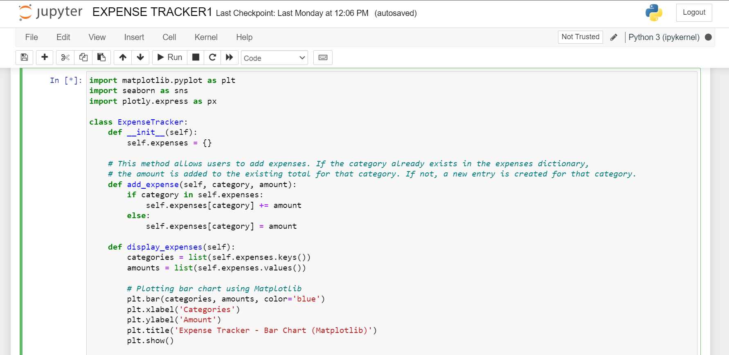
CODE SNIPPETS

Slide 12
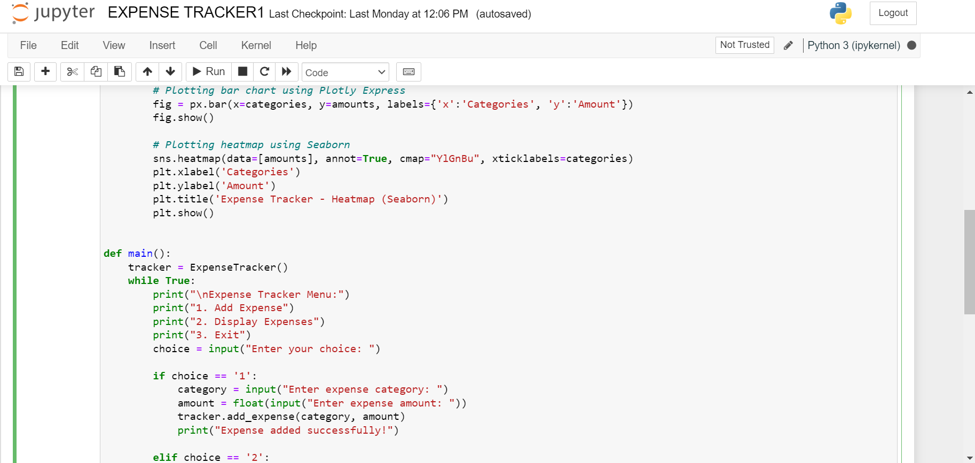

Slide 13
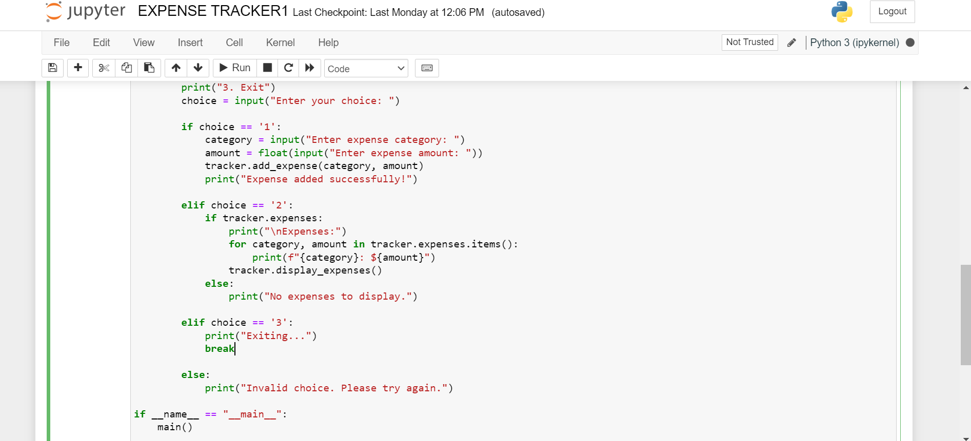

Slide 14
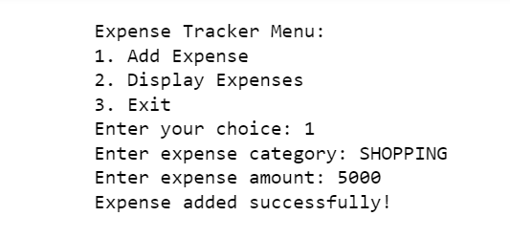
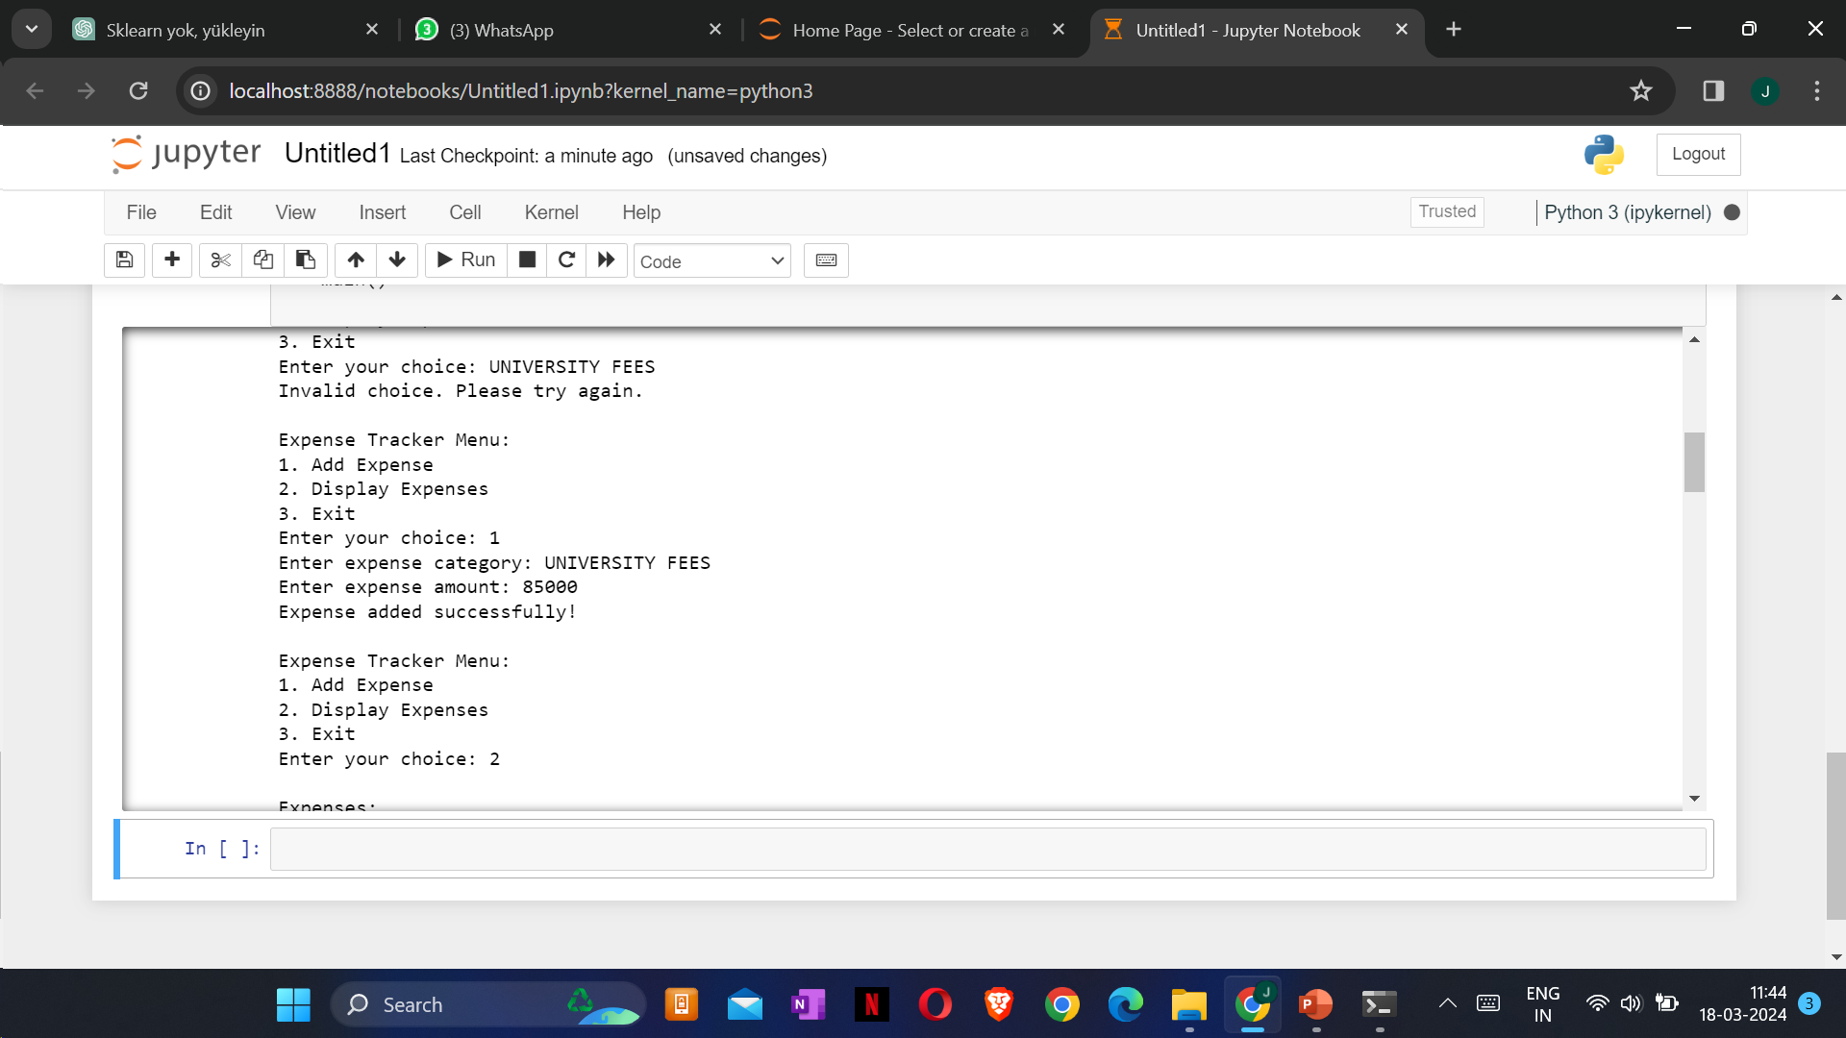
ADDING EXPENSES

Slide 15
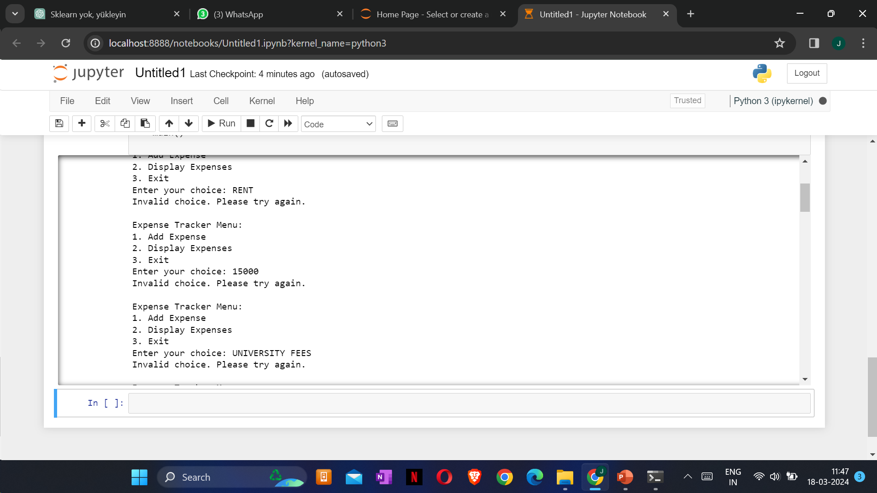
ERROR HANDLING

Slide 16
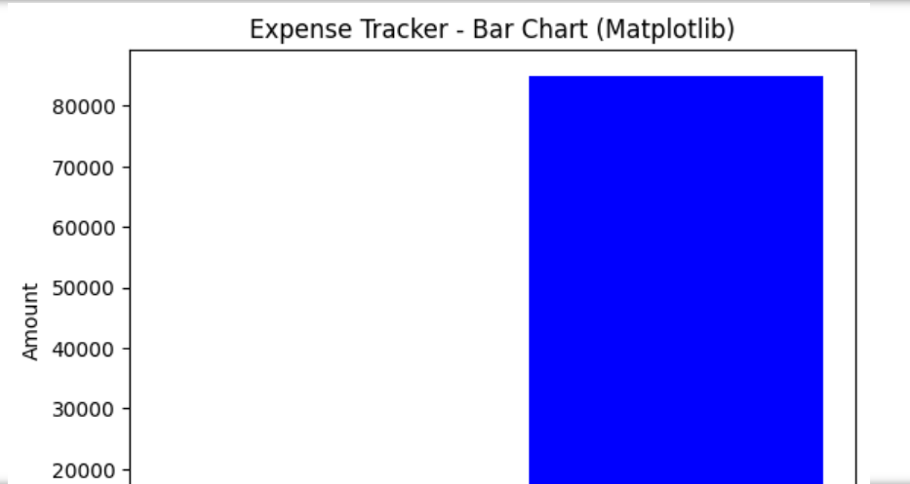
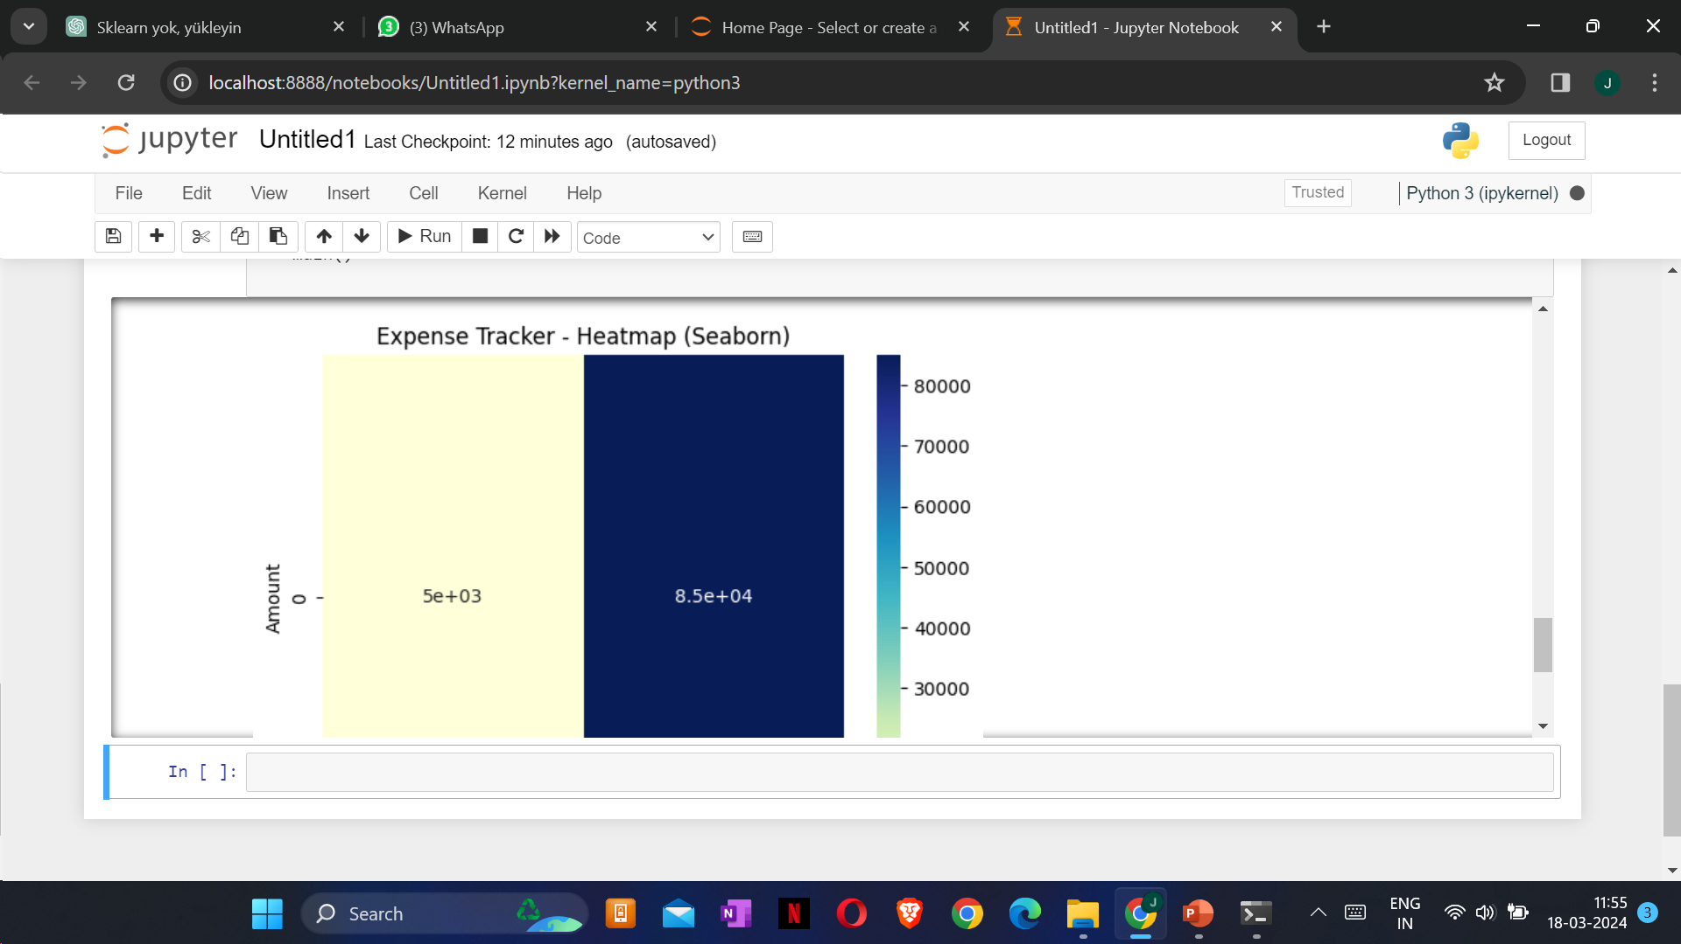
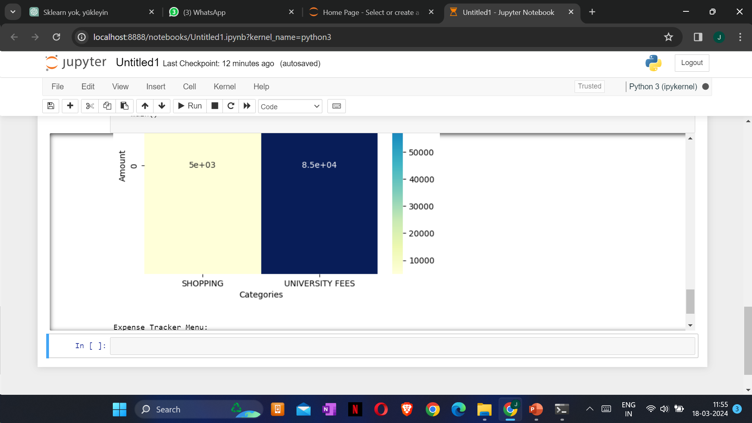
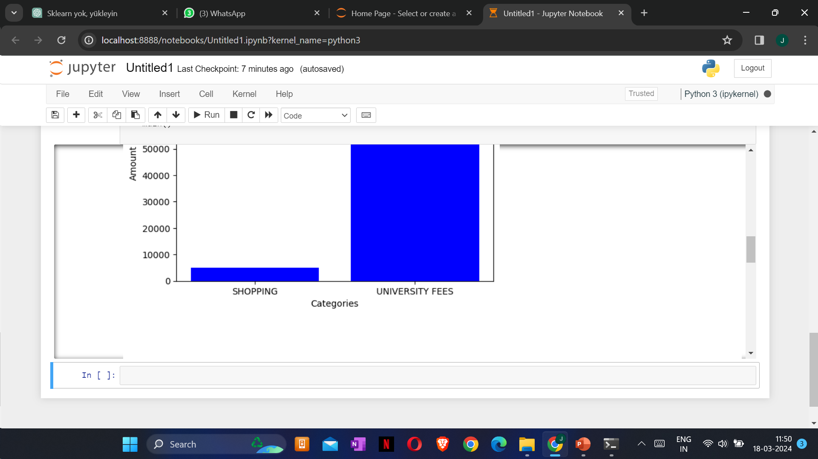
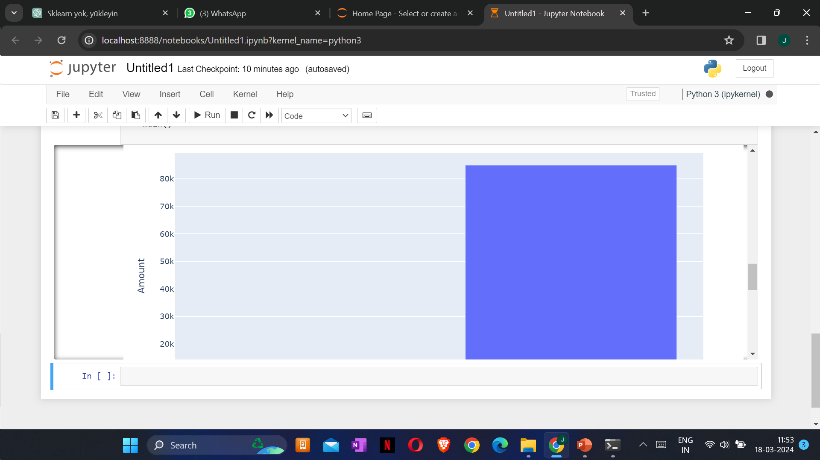
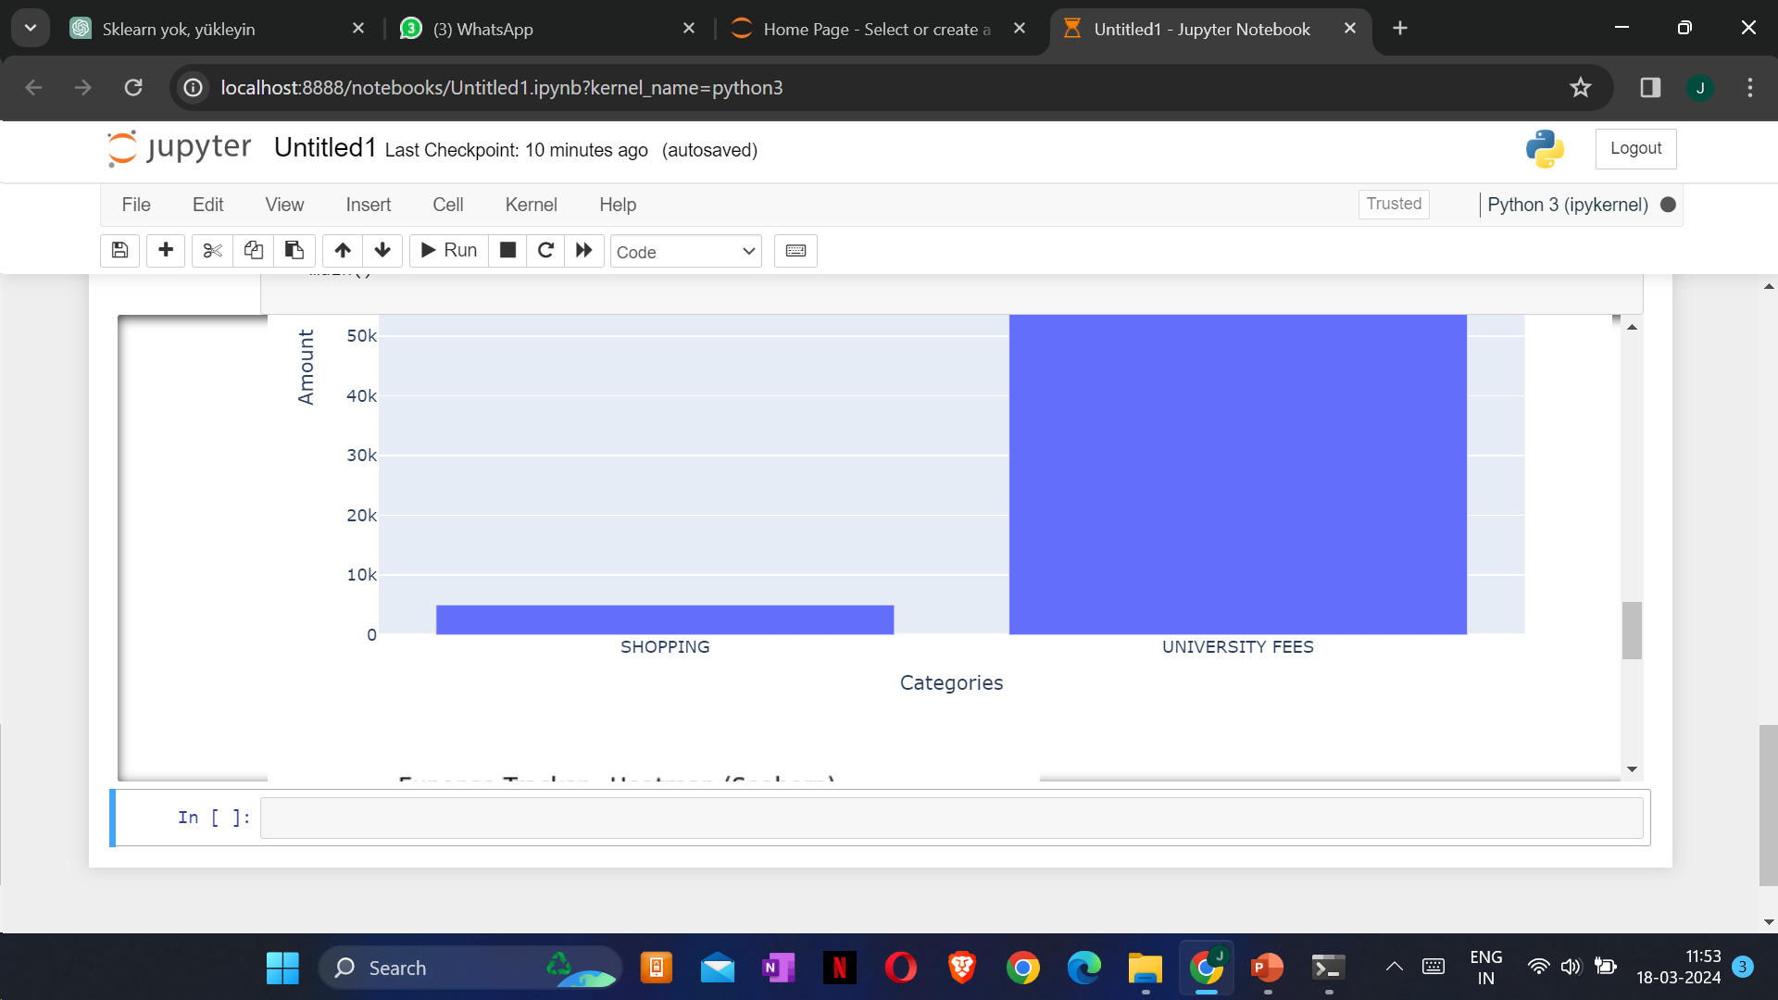
GRAPHS

Slide 17
THANK
YOU!

